Slide 2
Monetise free content.
Add breadth and depth to relationships with members – move to paying client, wider services.
Feeling of membership /belonging – loyalty /sticky customer.
Community/ centre of excellence/ thought leadership

Slide 3
Standard
8 p/m & 50 p/a
Premium
Three ABs a month
Cyber Newsletter
Webinars
PRR
K&R
Special Reports
Interactive special reports
In person events
Discount on training
Discount on GI
Podcast?
Ones to Watch?
Three questions for analyst
AKE Magazine
Special events

Slide 4
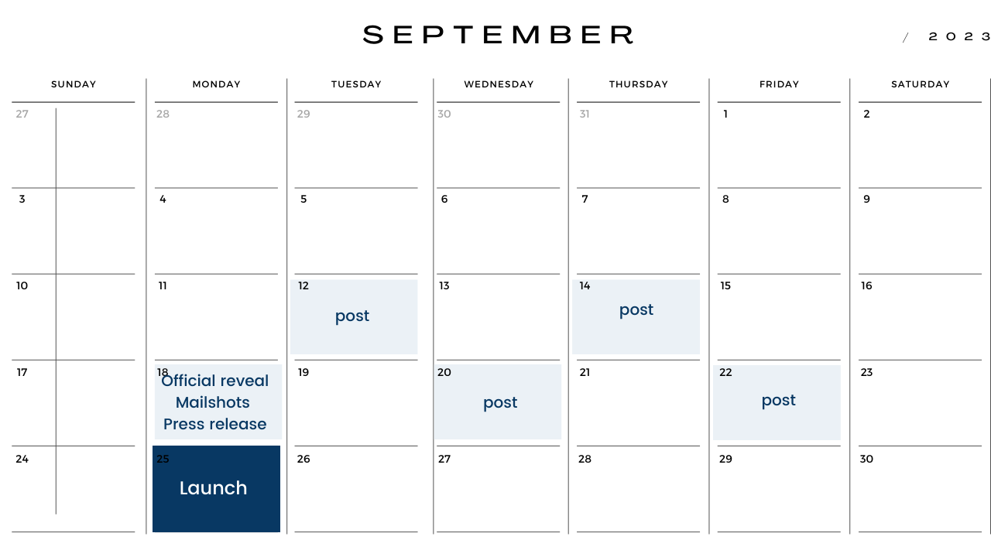

Slide 5
